Slide 1
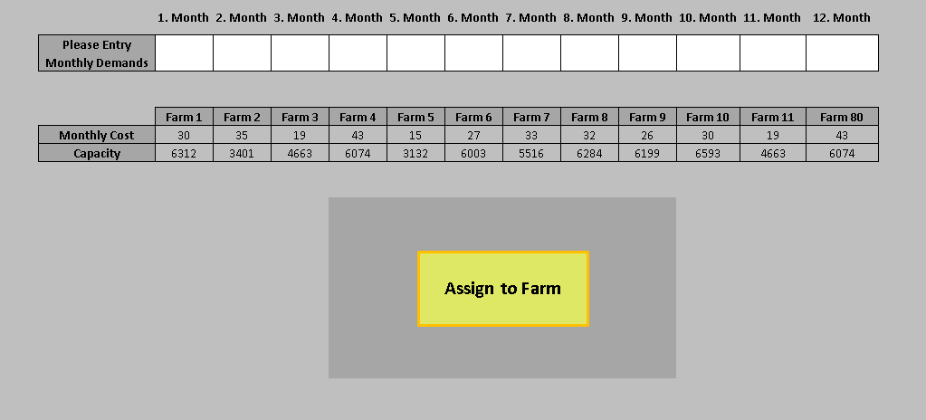
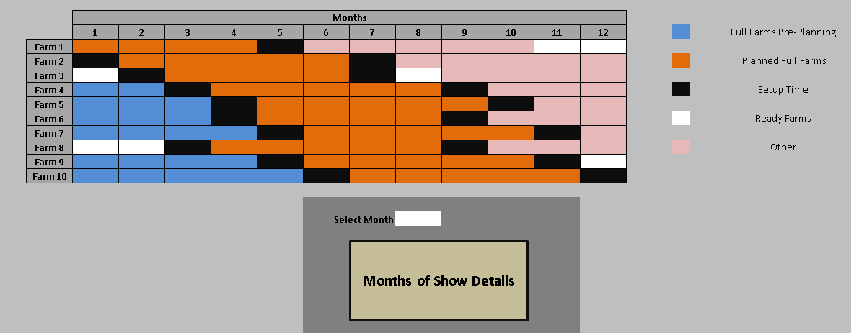
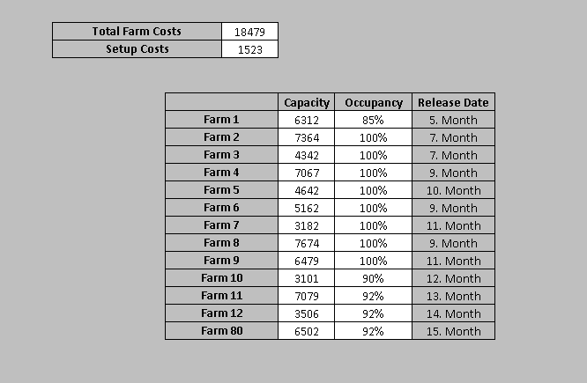
ÇAMLI YEM TURKEY BREEDING PLANNING SYSTEM
Gündüz İLSEVER, Ömer KEPENEK, Levent KANDİLLER, Sencer YERALAN, Demir ZÜMRÜT,
Yiğit AKSÜT, Hasan Ozan ELBİR, Kerem GÖZÜKARA
Çamlı Yem
Problem Definition
Solution Methodology
Çamlı Yem with it’s more than 10 brands has been in the animal feed and production business since 1983.
Cattle, Small Cattle, Poultry Feed
Fish Feed
Pet Food
Plant Nutrition
Pınar Fish Products
Denizden Retail Packs
Aquaculture Business
Cattle Husbandry
Poultry Business
Feed Production
Production of Organic
Organic Dairy Farming
The developed algorithm is compared with optimal solutions based on operating times and obtained results;
Model will be presented with its notation and set of constraints. The problem is to allocate the chicks to the farms with minimum cost in order to meet the weekly demand.
How many chicks? When to/from hatchery?
How many chicks to which farms? When?
Which farms to be subcontracted? (toms, hens)
How many turkeys ?
Operating cost analysis of the turkey breeding system
F | D | PK | Avarage Time | Max Time | Min Time | Optimal Avarage | Max Optimal | Min Optimal
F:U[10;50] | D:U[3000;90000] | -10% | 1'01''00''' | 2'16''38''' | 12''09''' | 8895 | 9100 | 8759
F:U[10;50] | D:U[3000;90000] | 10% | 1'03''10''' | 1'45''01'' | 15''47''' | 8895 | 9100 | 8759
F:U[10;50] | D:U[5000;70000] | -10% | 34''04''' | 1'9''47'' | 16''10''' | 7879 | 8286 | 7523
F:U[10;50] | D:U[5000;70000] | 10% | 57''06''' | 2'25''47'' | 11''11''' | 7879 | 8286 | 7523
F:u[20;40] | D:U[3000;90000] | -10% | 1'34'00''' | 2'46''31''' | 32''45''' | 8012 | 16067 | 9494
F:u[20;40] | D:U[3000;90000] | 10% | 2'09''00''' | 3'15'08 | 48''26''' | 8012 | 16067 | 9494
F:u[20;40] | D:U[5000;70000] | -10% | 57''11''' | 1'07''28''' | 47''21''' | 7650 | 7845 | 7392
F:u[20;40] | D:U[5000;70000] | 10% | 49''46''' | 56''12''' | 41''27''' | 7650 | 7845 | 7392
Decision Support System
System Analysis
Modeling And Formulating
Egg
Turkey
Hatcher
Setter
Breeding
Farm
Pınar Et
Setter
Causes And Symptoms
Type
Scheduling
Delivery
Infection
Environment Condition
Feed
Yield Loss
Demand
Sets
T Weeks, in index t t=1,…,T
J Farms, in index j j=1,…,J
G Types, in index g g=1,…,G
Parameters
F_{j} Weekly operating cost of a farm (TL)
A_{j} Farm capacity (#chick)
D_{t} Weekly demand (chick equivalent)
L_{g} Transition time of chicks into turkeys (weekly)
K Weekly number of chicks taken from the hatchery
P Efficiency ratio of hatchery (%)
Del Male breed percentage (%)
M Large number
Decision Variables
Y_{tj} 1, Farm is busy in week t 0,otherwise
Z_{tjg} 1, The moment the farm is ready for the new herd; t, g X_{tjg} Weekly number of chicks to be sent to farm J
Cost
Planning Errors
Forecasting Errors
Feed Cost
Transportation Cost
Operating Cost
Efficiency
FCR Level
Literature Survey
Aggregate Production Planning
Linear Programming
Mixed-Integer Programming
*Introduction to Operations Research 7th Edition Hillier And Lieberman
*Production and Operations Analysis 6th Edition Steven Nahmias

