Slide 1
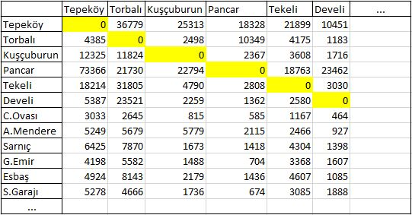
İZBAN A.Ş
SOLUTION METHODOLOGY
In collaboration with İZBAN we have generated and scheduled five alternative policies
Section A
A Joint Venture
Average SystemTime per Passenger =
(System Time)*(Number of Passengers)
Total Number of Passengers
began activities in 2010
700 employees
the most crowded commuter system in Turkey
100,000 + passengers daily
total line length is 79 km
System Time
Number of Passengers
Headways during different time intervals
System Time*Number of Passengers
Time Interval | Headway for section A | Headway for section B
05:30 – 08:55 | 20 min | 10 min
09:07 – 16:33 | 24 min | 12 min
16:43 – 19:55 | 20 min | 10 min
20:08 – 22:20 | 24 min | 12 min
22:44 – 00:00 | 24 min | 24 min
CURRENT SITUATION
SYMPTOMS
Section B
The line is planned to be extended so a new train schedule should be generated including section C
Service rate is supposed to be increased ( decreasing headways)
Time Interval | Headway for section A | Headway for section B | Headway for section C
05:30 – 08:55 | 20 min | 6 min | 20 min
09:07 – 16:33 | 24 min | 8 min | 24 min
16:43 – 19:55 | 20 min | 6 min | 20 min
20:08 – 22:20 | 24 min | 8 min | 24 min
22:44 – 00:00 | 24 min | 24 min | 24 min
COMPARISON
Policies | Average Travel Time per Passenger (A) | Average Waiting Time per Passenger (B) | Average System Time per Passenger (A+B) | Improvement Rate of Avg. System Time | Improvement Rate of Avg. Waiting Time
Alternative Policy 3 | 30.68 | 2.53 | 33.22 | 3.3% | 30.3%
Alternative Policy 2 | 30.68 | 2.63 | 33.31 | 3% | 27.7%
Alternative Policy 3.1 | 30.68 | 2.81 | 33.49 | 2.4% | 22.7%
Current Policy | 30.68 | 3.64 | 34.32 | 0% | 0%
Alternative Policy 3.2 | 30.68 | 3.97 | 34.66 | - 0.9% | - 9.1%
Alternative Policy 1 | 30.68 | 4.15 | 34.83 | - 1.4% | - 13.9%
PERFORMANCE MEASURES
The number of trains used for different policies
Total travel time (system time) for a passenger travels between terminuses
Improvement in Average Waiting time = 30.3%
Improvement in Average System time = 3.3%
PLANNING FACTORS
LITERATURE REVIEW
Section C
Wang, Y., De Schutter, B., and Van den Boom T., Origin-Destination Depended Train Scheduling Problem with Stop-Skipping for Urban Rail Transit Systems, Proceedings of the 93rd Annual Meeting of the Transportation Research Board, 2014.
C.A. Brebbia, N. Tomii, P. Tzieropoulos, J.M. Mera, Computers in Railways XIV- Railway Engineering Design and Optimization, WIT Press, 2014.
The line is shared with T.C.D.D.( National Railways)
Alsancak station has a complex structure
Safety Rules

