Slide 1
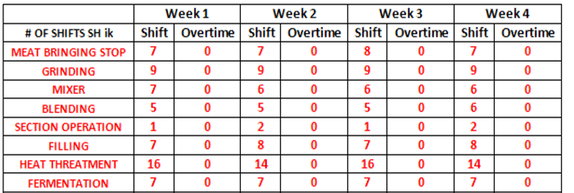
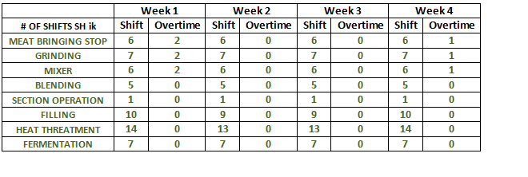
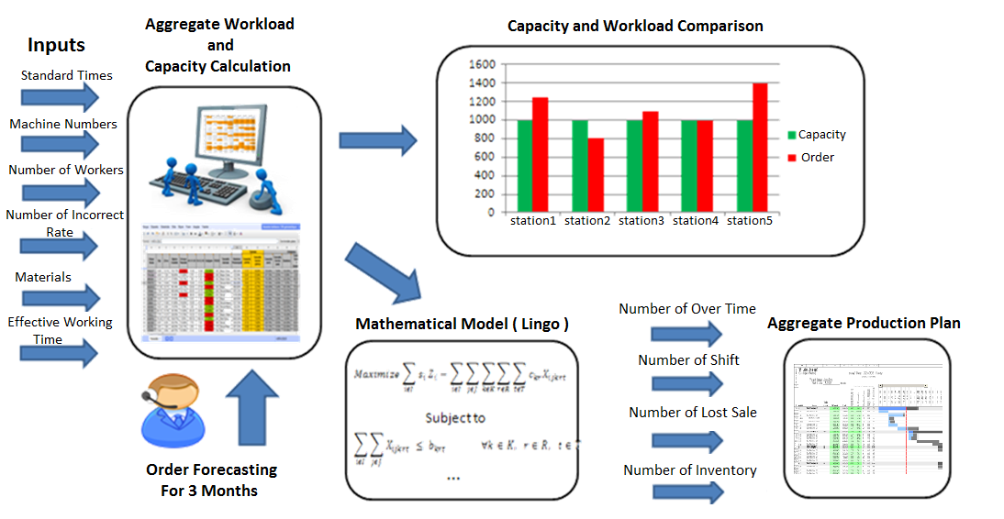
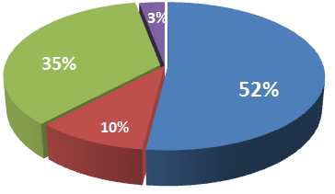
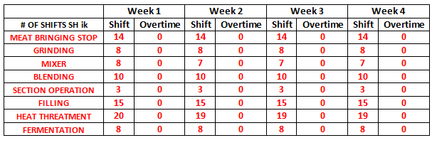
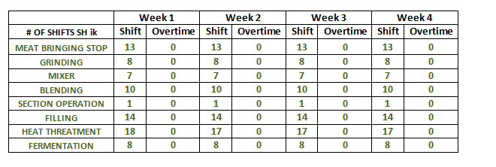
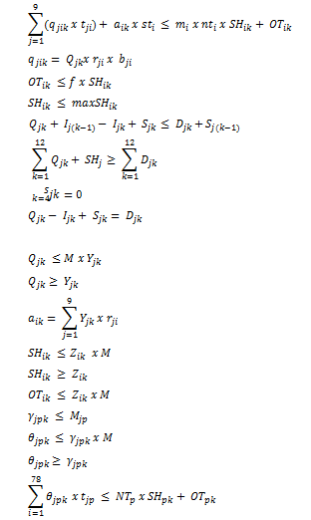
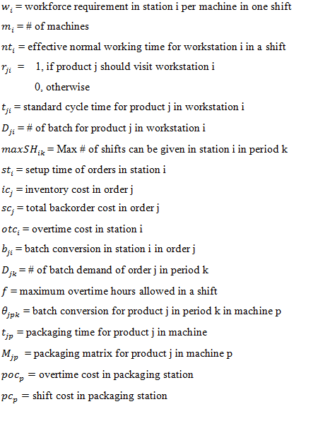
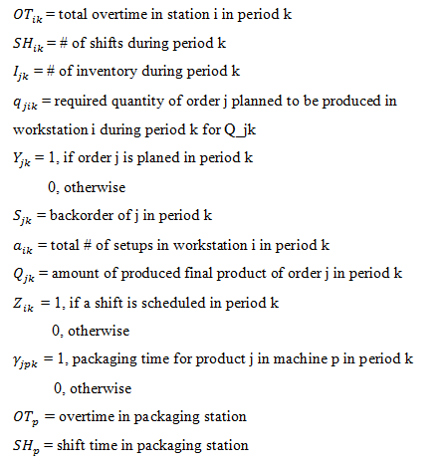
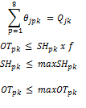
CAPACITY AND AGGREGATE PRODUCTION PLANNING FOR CHARCUTERIE PRODUCTS IN PINAR ET
KARTAL EFE ERKEKLER ALİ ERGİN HALİL EMRE TOK GÜNEŞ ÇELEBİ CEM GÜLEÇ
SUPERVISORS: ALİ KARGINER MUSTAFA KOŞAR İLKER PARLAK
ADVISORS: ÖMER ÖZTÜRKOĞLU BAHAR TURAN
DEPARTMENT OF INDUSTRIAL ENGINEERING, YASAR UNIVERSITY
INTRODUCTION
PROBLEM DEFINITION
VERIFICATION & VALIDATON
Pınar Et is started production in Kemalpaşa, İzmir in 1985 and now with a
593 million TL net sales in 2013, Pınar Et is leader company in meat sector.
Changes in capacity due to seperation of production areas of beef and poultry charcuterie products
Imbalance of workload and capacity in stations
Mismanagement of capacity of stations
Q: Which order is produced in what amount in a given time period? How many shifts and overtime are required to meet demand?
PRODUCT FAMILIES
Charcuterie Products
Soudjouk
Salami
Sausage
According to Company Data
According to Our Result
Fresh Meat Products
Turkey
Beef
Lamb
Frozen Meat Products
Burger
Meatballs
Coated Products
SOLUTION METHODOLOGY
SYSTEM ANALYSIS
CHARCUTERIE
FRESH MEAT
ADVANCED PROCESSED
OTHERS
% Revenue generated by main
Product families
MODELING AND FORMULATING THE PROBLEM
PARAMETERS
DECISION VARIABLES
APPLICABILITY OF PROPOSED APPROACH & CONCLUSION AND DISCUSSION
With the help of DSS that we developed, the capacity which is not known fully
İs started to be directed better.
By the help of DSS that we developed, planning department decides easly
which product to be produced or which producted to be denied among the
orders.
Through DSS, It is observed that denied orders started to be less
LITERATURE REVIEW

